Slide 1
INTRODUCTION TO DBMS

Slide 2
Outline
Data Processing and its types
The Need for Databases
Data Models
Relational Databases
Database Design
Storage Manager
Query Processing
Transaction Manager

Slide 3
Data Processing
Manipulation of data by computer.
Conversion of raw data into machine readable form
Use of computer to perform operations
Data Processing Types
  File Processing System.
  Database Management System.
File Processing System.
  Stores permanent records in various files
  Needs different application programs to extract records from, and add records to, the appropriate files.

Slide 4
File Processing System
Each and Every subsystem will have its own set of files
The concept of conventional file processing system is shown below, which consist of three applications namely, Application X, Application Y, Application Z.
Name of Application | Input | Report
Application X | File 1 and File 2 | Report 1, Report 2, Report 3
Application Y | File 1, File 3 , File 4 | Report 4, Report 5
Application Z | File 4, File 5 | Report 6

Slide 5
Drawbacks of using file systems to store data
Data redundancy and inconsistency
  Multiple file formats, duplication of information in different files
Difficulty in accessing data
  Need to write a new program to carry out each new task
Data isolation
  Multiple files and formats
Integrity problems
  Integrity constraints (e.g., account balance > 0) become “buried” in program code rather than being stated explicitly
  Hard to add new constraints or change existing ones

Slide 6
Database Management System (DBMS)
DBMS contains information about a particular enterprise
  Collection of interrelated data
  Set of programs to access the data
  An environment that is both convenient and efficient to use
Database Applications:
  Banking: transactions
  Airlines: reservations, schedules
  Universities: registration, grades
  Sales: customers, products, purchases
  Online retailers: order tracking, customized recommendations
  Manufacturing: production, inventory, orders, supply chain
  Human resources: employee records, salaries, tax deductions
Databases can be very large.
Databases touch all aspects of our lives

Slide 7
Drawbacks of using file systems to store data (Cont.)
Atomicity of updates
  Failures may leave database in an inconsistent state with partial updates carried out
  Example: Transfer of funds from one account to another should either complete or not happen at all
Concurrent access by multiple users
  Concurrent access needed for performance
  Uncontrolled concurrent accesses can lead to inconsistencies
    Example: Two people reading a balance (say 100) and updating it by withdrawing money (say 50 each) at the same time
Security problems
  Hard to provide user access to some, but not all, data
Database systems offer solutions to all the above problems

Slide 8
University Database Example
Application program examples
  Add new students, instructors, and courses
  Register students for courses, and generate class rosters
  Assign grades to students, compute grade point averages (GPA) and generate transcripts
In the early days, database applications were built directly on top of file systems

Slide 9
Levels of Abstraction
A major purpose of a database system is to provide users with an abstract view of the data.
The system hides certain details of how the data are stored and maintained.
Since many database-system users are not computer trained, developers hide the complexity from users through several levels of abstraction
Physical level: describes how a record (e.g., instructor) is stored.
Logical level: describes data stored in database, and the relationships among the data.
  type instructor = record
  ID : string;
  name : string;
  dept_name : string;
  salary : integer;
        end;
View level: application programs hide details of data types. Views can also hide information (such as an employee’s salary) for security purposes.

Slide 10

View of Data
An architecture for a database system
Highest level
Next higher Level
Lowest Level

Slide 11
Instances and Schemas
The collection of information stored in the database at a particular moment is called an instance of the database.
The overall design of the database is called the database schema.
For e.g Program written in a programming language
A database schema corresponds to the variable declarations (along with associated type definitions) in a program.
Each variable has a particular value at a given instant. The values of the variables in a program at a point in time correspond to an instance of a database schema.

Slide 12
Instances and Schemas
Similar to types and variables in programming languages
Logical Schema – the overall logical structure of the database
  Example: The database consists of information about a set of customers and accounts in a bank and the relationship between them
    Analogous to type information of a variable in a program
Physical schema– the overall physical structure of the database
Instance – the actual content of the database at a particular point in time
  Analogous to the value of a variable
Subschemas –A database may also have several schemas at the view level, sometimes called subschemas, that describe different views of the database.

Slide 13
Data Independence
If a database system is not multi-layered, then it becomes difficult to make any changes in the database system.
Metadata itself follows a layered architecture, so that when we change data at one layer, it does not affect the data at another level. This data is independent but mapped to each other.
Logical Data Independence Logical data is data about database, that is, it stores information about how data is managed inside.
  For example, a table (relation) stored in the database and all its constraints, applied on that relation.
Physical Data Independence – the ability to modify the physical schema without changing the logical schema
  Applications depend on the logical schema
  In general, the interfaces between the various levels and components should be well defined so that changes in some parts do not seriously influence others

Slide 14
Data Models
A collection of tools for describing
  Data
  Data relationships
  Data semantics
  Data constraints
Relational model
Entity-Relationship data model (mainly for database design)
Object-based data models (Object-oriented and Object-relational)
Semistructured data model (XML)
Other older models:
  Network model
  Hierarchical model

Slide 15

Relational Model
All the data is stored in various tables.
Example of tabular data in the relational model
Columns
Rows

Slide 16

A Sample Relational Database

Slide 17
Relational Model
Advantages
Structural Independence: database structure can be changed without affecting DBMS’ capability to access data
Conceptual Simplicity: Designer has to concentrate only on logical view of the database not on the physical data storage details
Design, Implementation, Maintenance and Usage ease
Good for ad hoc requests
Simpler to navigate
Greater flexibility
Disadvantages
H/W and S/W overheads
Not good for Transaction processing modeling as hierarchical and network models
Slower processing time than hierarchical and network models

Slide 18
E-R Model
The entity-relationship (E-R) data model uses a collection of basic objects, called entities, and relationships among these objects
Entity : is a ‘thing’ or ‘object’ in the real world which is distinguishable form other objects. Examples: person, student, doctor, etc.
Relationship: is an association among several entities. Example: A depositor relationship associates a customer with each account that he has.

Slide 19
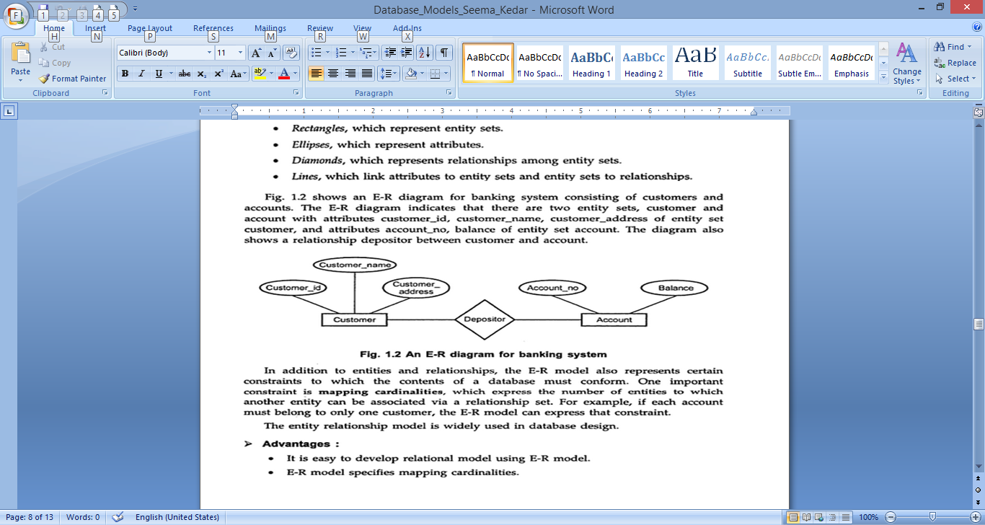
A Sample E-R Model
An E-R Diagram for banking system

Slide 20
E-R Model
Advantages:
Easy to develop relational model using E-R model
Specifies Mapping Cardinalities
Specifies keys like primary keys
Generalization and Specialization is possible
Disadvantages:
Used only for database design not for implementation

Slide 21
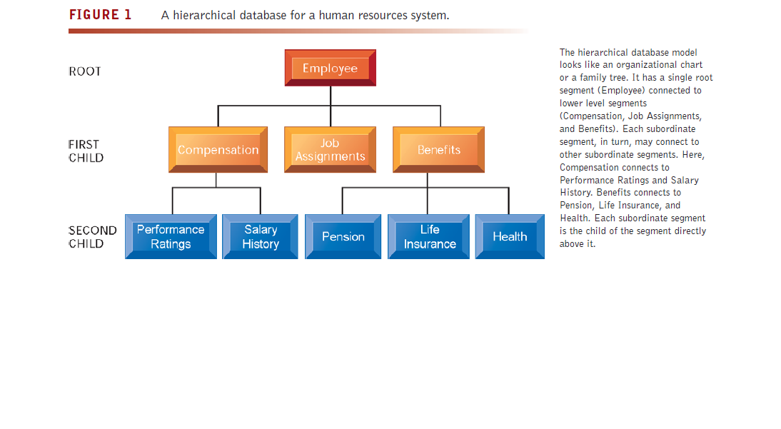
Hierarchical Model
The hierarchical DBMS is used to model one-to-many relationships, presenting data to users in a treelike structure
Within each record, data elements are organized into pieces of records
called segments
Top level segment is called the root. An upper segment is connected logically to a lower segment in a parent–child relationship
A parent segment can have more than one child, but a child
can have only one parent
..

Slide 22
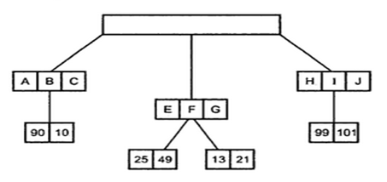
Hierarchical Model
Bank account holders records in hierarchical Model

Slide 23
Hierarchical Model
Advantages
High speed of access to large data sets
Ease of updates
Design is simple
First model to introduce the security in DBMS
Very efficient when the users require large number of transactions using data whose relationships are fixed.
Disadvantages
Implementation Complexity
Change in database requires to make necessary change in application programs which accesses the database
Uses physical storage paths to navigate the different segments. So if physical structure is changed, the application has to be modified too. (lack of structural independence)

Slide 24
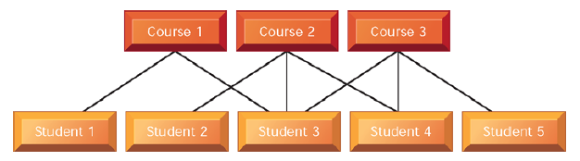
Network Model
The network DBMS depicts data logically as many-to-many relationships. That is parents can have multiple children, and a child can have more than one parent.
Example :There are many courses in a university and many students. A student takes many courses, and a course has many students.
Banks, insurance companies, etc. Are using this legacy data model.
..
Student course relationship

Slide 25
Network Model
Advantages
Conceptually simple and easy to design
Can handle 1:n as well as n:n relationships
The changes in data do not require changes to the application programs
Disadvantages
Detailed structured knowledge is required
Lack of structural independence (physical path)

Slide 26
Object-Relational Data Models
Relational model: flat, “atomic” values
Object Relational Data Models
  Extend the relational data model by including object orientation and constructs to deal with added data types.
  Allow attributes of tuples to have complex types, including non-atomic values such as nested relations.
  Preserve relational foundations, in particular the declarative access to data, while extending modeling power.
  Provide upward compatibility with existing relational languages.

Slide 27
XML: Extensible Markup Language
Defined by the WWW Consortium (W3C)
Originally intended as a document markup language not a database language
The ability to specify new tags, and to create nested tag structures made XML a great way to exchange data, not just documents
XML has become the basis for all new generation data interchange formats.
A wide variety of tools is available for parsing, browsing and querying XML documents/data

Slide 28
Database Users and User Interfaces
Naive users : unsophisticated users who interact with the system by invoking one of the application programs that have been written previously.
User interface is a forms interface, reports generated from the database
Example: consider a student, who during class registration
period, wishes to register for a class by using a Web interface
Casual end users occasionally access the database, but they may need different information each time. They use a sophisticated database query language to specify their requests and are typically middle- or high-level managers or other occasional browsers
Application Programmers computer professionals who write application
Programs. Rapid application development (RAD) tools enable an application programmer to construct forms and reports with minimal programming effort.

Slide 29
Database Users and User Interfaces
Sophisticated users: Interact with the system without writing programs. They form their requests either using a database query language or by using tools such as data analysis software. Analysts who submit queries to explore data in the database fall in this category.
Specialized users:
write specialized database applications such as computer-aided design systems, knowledgebase and expert systems, systems that store data with complex data types (i.e. graphics data and audio data)

Slide 30
Database Administrator
The person to have central control of both the data and the programs that access those data is called a database administrator (DBA). The functions of a DBA include:
Schema definition. The DBA creates the original database schema by executing a set of data definition statements in the DDL.
Storage structure and access-method definition.
Schema and physical-organization modification
Granting of authorization for data access.
Routine maintenance: database backup, ensuring free disk space, monitoring of jobs running on the database.

Slide 31
Database Engine
Storage manager
Query processing
Transaction manager

Slide 32
Storage Management
Storage manager is a program module that provides the interface between the low-level data stored in the database and the application programs and queries submitted to the system.
The storage manager is responsible to the following tasks:
  Interaction with the OS file manager
  Efficient storing, retrieving and updating of data
Issues:
  Storage access
  File organization
  Indexing and hashing

Slide 33

Query Processing
1. Parsing and translation
2. Optimization
3. Evaluation

Slide 34
Query Processing (Cont.)
Alternative ways of evaluating a given query
  Equivalent expressions
  Different algorithms for each operation
Cost difference between a good and a bad way of evaluating a query can be enormous
Need to estimate the cost of operations
  Depends critically on statistical information about relations which the database must maintain
  Need to estimate statistics for intermediate results to compute cost of complex expressions

Slide 35
Transaction Management
What if the system fails?
What if more than one user is concurrently updating the same data?
A transaction is a collection of operations that performs a single logical function in a database application
Transaction-management component ensures that the database remains in a consistent (correct) state despite system failures (e.g., power failures and operating system crashes) and transaction failures.
Concurrency-control manager controls the interaction among the concurrent transactions, to ensure the consistency of the database.

Slide 36

Database Users and Administrators
Database

Slide 37

Database System Internals

